Slide 1
Max Montaseri
Back-End & Front-End Integration
AWS Serverless Microservices

Slide 2

















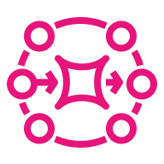


AWS Serverless Microservices: AppSync GraphQL + DynamoDB Streams
Client
GraphQL/API Layer
Data & Event-Driven Microservices
Web and External Clients
AWS AppSync with GraphQL and optional REST API
DynamoDB, Streams, Event Processing and Asynchronous Microservices
JWT token
(in Authorization header)
Authentication & Authorization
(Issues JWT)
Writes
(Orders)
Optional: DynamoDB Accelerator (DAX)
(Only for demonstrated
read-latency/throughput need)
End Users
(Web / Mobile)
Amazon
Cognito
(User Pool)
Query / Mutation Resolver
Amazon DynamoDB
(Orders Table)
DynamoDB Data
Source (for simple CRUD/query)
INSERT / MODIFY / REMOVE
GraphQL
Query / Mutation
(HTTPS)
DynamoDB Streams
Lambda Data Source
(for complex business logic)
Lambda publishes AppSync mutation
(e.g. publishOrderUpdate)
AWS AppSync
(GraphQL API)
AWS AppSync
GraphQL API
React Web App
with Apollo Client
Stream Processing Lambda
(Validate, Transform,
Idempotency, Enrich)
GraphQL Subscriptions
(Real-time updates
to connected clients)
Apollo Client
(In-memory Cache)
GraphQL Subscriptions
(Real-time updates
to connected clients)
Optional
AppSync Caching
(for cached queries)
Publish domain events
(OrderCreated/Updated/Deleted)
Amazon SNS
(Topic - Fan-out)
Amazon EventBridge
(Optional - additional
event routing)
Optional: External
REST Clients
(Legacy systems)
REST / HTTP
(HTTPS)
SQS Queue
(Order Processor)
SQS Queue
(Inventory Service)
SQS Queue
(Notification Service)
Amazon API Gateway
(Optional - for REST/HTTP)
Lambda
(REST API Handler)
For legacy or external
REST clients only
Lambda
Consumer
(Order Service)
DLQ
(on failure)
Lambda Consumer
(Inventory Service)
DLQ
(on failure)
Lambda Consumer
(Notification Service)
DLQ
(on failure)
Security & Observability (Cross-Cutting Concerns)
Legend
Reliability
Retry policies Idempotency
Dead-letter queues (DLQs)
Error handling
Synchronous GraphQL equest/response (HTTPS)
AWS IAM
Least-privilege roles
for AppSync, Lambda,
DynamoDB, SNS, SQS, etc.
AWS KMS
Encryption at rest
(DynamoDB, SQS, etc.) and in transit (TLS)
Amazon CloudWatch
Logs, Metrics, Alarms, Dashboards
AWS X-Ray
Distributed tracing
(across AppSync, Lambda, etc.)
Real-time subscription flow
(WebSockets)
Asynchronous event flow (SNS/SQS/EventBridge)
Optional flow

Slide 3
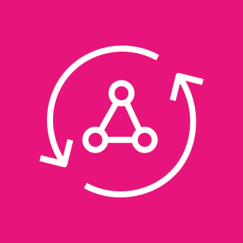

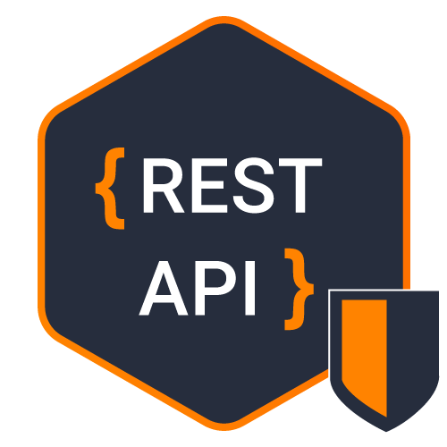
AWS AppSync
GraphQL
vs
RESTful API

Slide 4
RESTful API (Representational State Transfer Application Programming Interface)
When a RESTful API is called, the server will transfer a representation of the requested resource's state to the client system
RESTful API
Uses HTTP verbs: POST, PUT, PATCH, DELETE, GET
  Insert: POST
  Update: PUT
  Partially update: PATCH
  Delete: DELETE
  Return all: GET
  Return one: GET/Id
Get all => URL/customer/
Get: => URL/customer/C100
RESTful API is entity based components
GET https://dell.ut.com/api/customers
GET https://dell.ut.com/api/customers/1
POST https://dell.ut.com/api/customers
PUT https://dell.ut.com/api/customers/1
DELETE https://dell.ut.com/api/customers/12
POST /echo/post/json HTTP/1.1
Host: reqbin.com
Accept: application/json
Content-Type: application/json
Content-Length: 81
{
"Id": 78912,
"Customer": "Jason Sweet",
"Quantity": 1,
"Price": 18.00
}
HTTP headers
Request headers are the metadata exchanged between the client and server. For instance, the request header indicates the format of the request and response, provides information about request status, and so on
Data (Jason body)
REST API requests might include data for the POST, PUT, and other HTTP methods to work successfully
Parameters (Jason body)
RESTful API requests can include parameters that give the server more details about what needs to be done. The following are some different types of parameters:
  Path parameters that specify URL details.
  Query parameters that request more information about the resource.
  Cookie parameters that authenticate clients quickly.

Slide 5
GraphQL
GraphQL concept is implemented in different technology stacks by third parties such as AWS AppSynch
Not HTTP verbs any more! PUT, PATCH, DELETE, GET
GraphQL Components
1. Query: Read data
pass variables for DB fetch/Get
2. Mutation: Write data
passing variables for DB Insert/Update/Delete
3. Subscription:
  Like queries, subscriptions enable you to fetch data
  Unlike queries, subscriptions are long-lasting operations that can change their result over time
  They can maintain an active connection to your GraphQL server (most commonly via WebSocket), enabling the server to push updates to the subscription's result
  Subscriptions are useful for notifying your client in real time about changes to back-end data, such as the creation of a new object or updates to an important field.
Put query commands in the request body
  Insert: Mutation
  Update: Mutation
  Partially update: Mutation
  Delete: Mutation
  Return all: Query
  Return one: Query
GraphQL Advantages
Flexibility: Customizing what DB fields we’re looking for
Database Performance: Decrease database overload regarding technology stack such as AWS AppSync DynamoDB resolvers automatically apply the queries only on mentioned fields
Network Performance: Decrease network overload with data fetch customization (OData for remediate RESTful API )
GraphQL Resolver fields: Implementing aggregation functions if you have it in sent query
Exp. For phone devices
Minimal data is important
RESTful API returns all entity’s fields (bulk data)
Show up lists in cart view not in Grid (limited screen)
Network overload in returned KBs
Design different GraphQL endpoint for phone devices

Slide 6
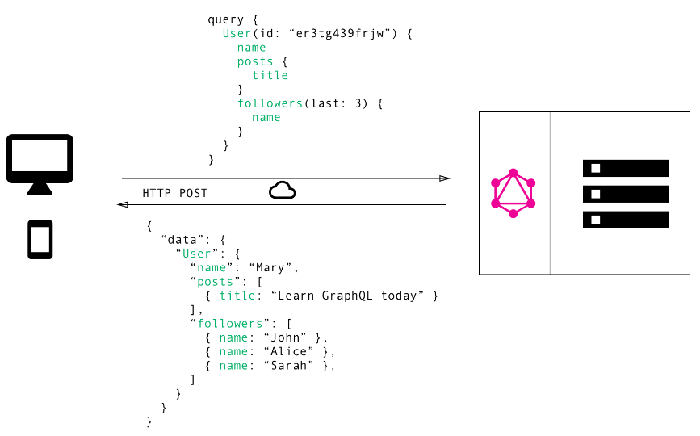
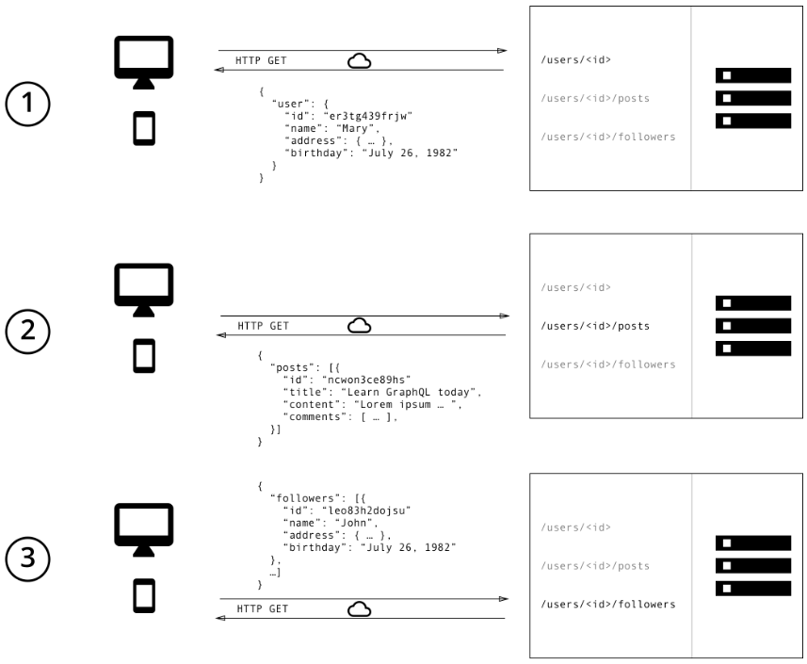
GraphQL vs RESTful API
Data Fetching
In GraphQL on the other hand, you’d simply send a single query to the GraphQL server that includes the concrete data requirements. The server then responds with a JSON object where these requirements are fulfilled.
Data Fetching
With a REST API, you would typically gather the data by accessing multiple endpoints

Slide 7
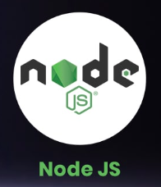
AWS AppSync
Implemented GraphQL technologically
✔ A single data API: Simplify application development with GraphQL APIs by providing a single endpoint to securely query or update data from multiple databases, microservices, and APIs.
✔ Built for real-time experiences: Easily create engaging real-time experiences with Pub/Sub APIs by automatically publishing data updates to subscribed API clients via serverless WebSockets connections.
✔ 100% serverless: Secure, monitor, log, and trace your APIs via built-in support for AWS WAF, CloudWatch and X-Ray. Fully managed setup, administration, auto-scaling, and high-availability.
Node.js
Uses Apollo Server (server-side) and Apollo Client (client-side) for Implemented GraphQL concept

Slide 8
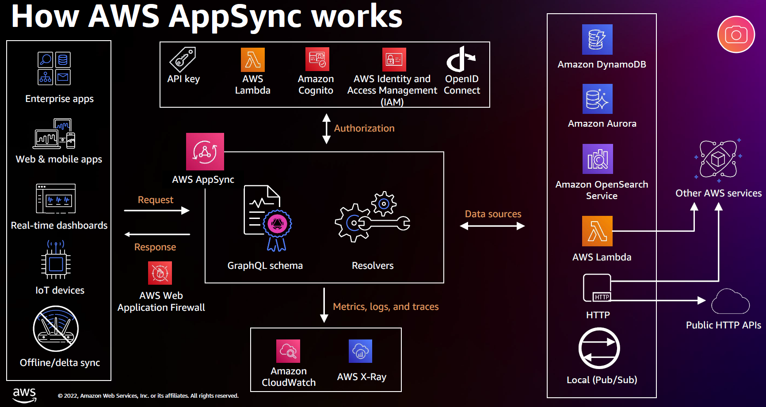

Slide 9
AWS AppSync
GraphQL
AWS Serverless Architecture
Back-End & Front-End Integration

Slide 10
AWS Serverless Microservices: AppSync GraphQL + DynamoDB Streams
Client
GraphQL/API Layer
Data & Event-Driven Microservices
Web and External Clients
AWS AppSync with GraphQL and optional REST API
DynamoDB, Streams, Event Processing and Asynchronous Microservices
JWT token
(in Authorization header)
Authentication & Authorization
(Issues JWT)
Writes
(Orders)
Optional: DynamoDB Accelerator (DAX)
(Only for demonstrated
read-latency/throughput need)
End Users
(Web / Mobile)
Amazon
Cognito
(User Pool)
Query / Mutation Resolver
Amazon DynamoDB
(Orders Table)
DynamoDB Data
Source (for simple CRUD/query)
INSERT / MODIFY / REMOVE
GraphQL
Query / Mutation
(HTTPS)
DynamoDB Streams
Lambda Data Source
(for complex business logic)
Lambda publishes AppSync mutation
(e.g. publishOrderUpdate)
AWS AppSync
(GraphQL API)
AWS AppSync
GraphQL API
React Web App
with Apollo Client
Stream Processing Lambda
(Validate, Transform,
Idempotency, Enrich)
GraphQL Subscriptions
(Real-time updates
to connected clients)
Apollo Client
(In-memory Cache)
GraphQL Subscriptions
(Real-time updates
to connected clients)
Optional
AppSync Caching
(for cached queries)
Publish domain events
(OrderCreated/Updated/Deleted)
Amazon SNS
(Topic - Fan-out)
Amazon EventBridge
(Optional - additional
event routing)
Optional: External
REST Clients
(Legacy systems)
REST / HTTP
(HTTPS)
SQS Queue
(Order Processor)
SQS Queue
(Inventory Service)
SQS Queue
(Notification Service)
Amazon API Gateway
(Optional - for REST/HTTP)
Lambda
(REST API Handler)
For legacy or external
REST clients only
Lambda
Consumer
(Order Service)
DLQ
(on failure)
Lambda Consumer
(Inventory Service)
DLQ
(on failure)
Lambda Consumer
(Notification Service)
DLQ
(on failure)
Security & Observability (Cross-Cutting Concerns)
Legend
Reliability
Retry policies Idempotency
Dead-letter queues (DLQs)
Error handling
Synchronous GraphQL equest/response (HTTPS)
AWS IAM
Least-privilege roles
for AppSync, Lambda,
DynamoDB, SNS, SQS, etc.
AWS KMS
Encryption at rest
(DynamoDB, SQS, etc.) and in transit (TLS)
Amazon CloudWatch
Logs, Metrics, Alarms, Dashboards
AWS X-Ray
Distributed tracing
(across AppSync, Lambda, etc.)
Real-time subscription flow
(WebSockets)
Asynchronous event flow (SNS/SQS/EventBridge)
Optional flow

Slide 11
Infrastructure Stack
The Infrastructure Stack provisions all common AWS services and Micrometrics only use them.
Networking (VPC)
DynamoDB
DynamoDBVpcEndpoint-prod Type: Gateway
VpcLambda-sg-prod Rule: allowAllOutbound
ApiVpcEndpoint-prod Type: Interface For execute API from VPC
VpcEndpoint-sg-prod Ingress rule: https or port 443 and allowAllOutbound rule
cloudfront-edge-apigateway
Custom Domain for invoking REST API: cloudfront-edge-apigateway.prod.domain.org
Amazon Route 53 Alias record: prod.domain.org Target: cloudfront-edge-apigateway.-prod.domain.org
Amazon CloudFront Distribution
AWS Certificate Manager (ACM)
AWS Key Management Service (KMS)
Microservice Back-End Stack
Hierarchy (Nested or Root-Child) AWS CloudFormaton Stack Because AWS has a limitation in resource numbers (Error)
Each Microservice has its CDK Stack and Microservices are Isolated in
  Data (DynamoDB)
  Logic (Lambda)
No data and logic redundancy!
The Microservice CdkStack provisions all private AWS services for each microservice
DynamoDB Table (fully independent): table properties (fields)
Lambda (fully independent): Don’t call/invoke Lambda functions (Logical dependency) between Microservices => Lambda is triggered by APIGateway or SQS new message
API Gateway (fully independent): Lambda API methods ( POST, GET, PUT, PATCH)
SQS (not fully independent): Pushes message to each subscribed Microservices for using the item
SNS (not fully independent): Notifies subscribed Microservices after event triggered
Add Dependency:
DynamoDbStack output (DynamoDB Table) => pass to => SNSSQSTopicStack props => pass to => LambdaStack props => pass to => APIGateWayStack

